Slide 1

Clinical Handover to Community Pharmacy
James Allen
Deputy Chief Pharmacist – Clinical Services
12th September 2017

Slide 2
Scale of the problem
Only 16% of patients who are prescribed a new medicine take it as prescribed, experience no problems and receive as much information as they need⁽¹⁾.
Ten days after starting a medicine
    Almost a third of patients are already non-adherent – of these
      55% don’t realise they are not taking their medicines correctly
      45% are intentionally non-adherent.
Pharmacist counselling in outpatients with chronic disease reduced mortality from 17% to 11% over 2 years ⁽²⁾
Targeted pharmacist counselling has been shown to reduce readmission rates from 21.6% to 15.7%⁽³⁾

Slide 3
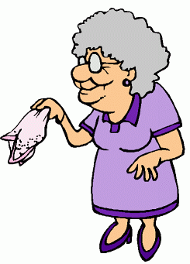
Meet Vera
Average number of medicines = 9
Average number of changes = 4
Average length of stay = 4 days
4 out of 5 times discharge medicines and plan organised on day of discharge
Has around a 1 in 10 chance of re-admission

Slide 4
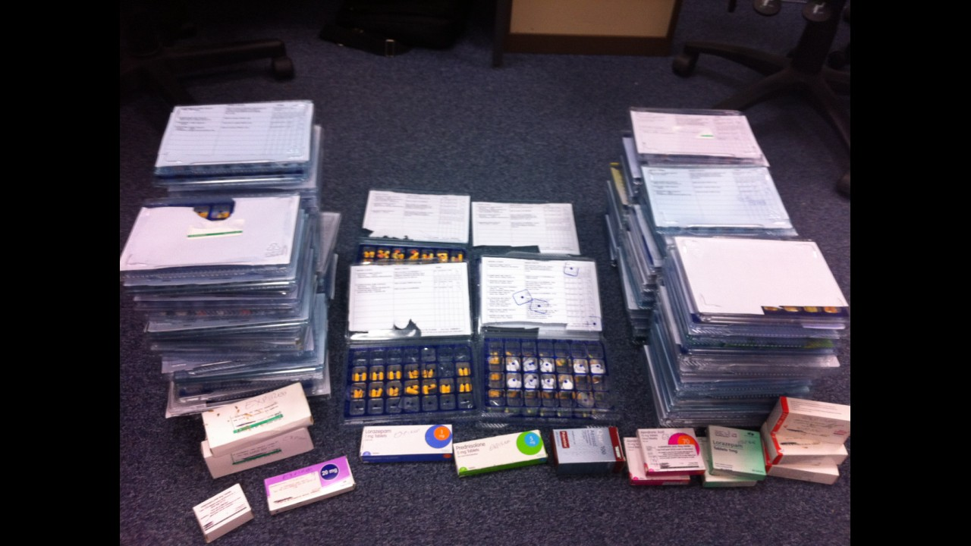
Notes:
This is the type of situation that needs to be avoided, over 1 years worth of trays in a pile. Confusion and lack of interest in their medicines were the predominant reasons for this occurring but consider the risks involved in all these trays. Some were significantly different reflecting changes in medicines over time. Furthermore consider how confusing this would be with the added confusion of all the separate medicines (including three brands of theophylline).

Slide 5
Further evidence of local need...
342 patient / carer medicines helpline calls last quarter
  55% about appropriateness or safety of medicines
  38% about how to take medicines
  19% about getting further medicines supplies
UHS is not paid for re-admissions equalling an approx. cost ~£3-4 million.
  Based on Newcastle data local health economy saving = £1.4 million

Slide 6
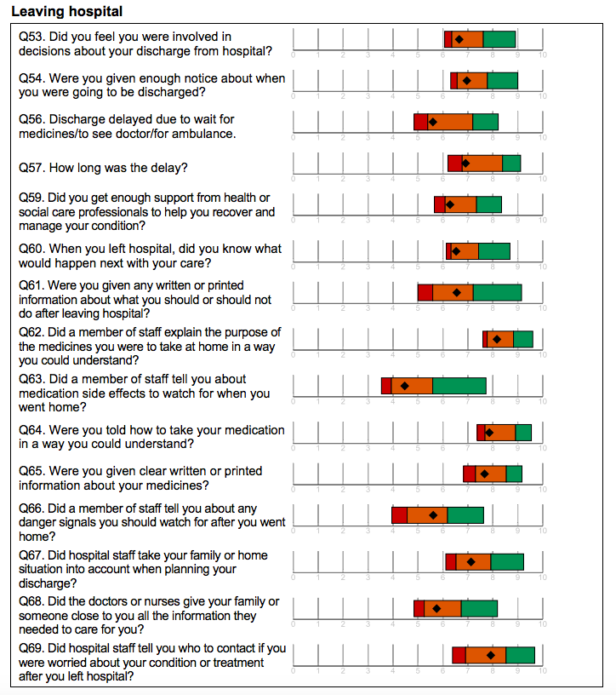
Discharge experience in the National Inpatient Survey
UHS scored near the bottom end as the average performance.
Of particular note is that patients felt:
They weren’t given enough support or information about what they should do or how to manage their condition (Q59, Q60, Q61, Q63, Q66, Q68) – all of these questions scored below 7/10
Overall, UHS scored a 6.8/10 for ‘Leaving Hospital’, suggesting from a patient perspective, we are not delivering a good standard of discharge that is response to their needs.

Slide 7
To consider: two major issues within discharge- underpinned by the same factor: communication
UHS want to deliver a timely discharge, but they also want clear information about the process itself and about their condition and medications.
Timeliness
Information
Process & system
Communication
Realism / expectations
Patient education
Clarity and written
Plain English
Additional information: e.g. Contact numbers, how to change appointments
Access to care for acute issues
Guide for self-managment of conditions
Access to expert advice
Effective
Communication
Positive patient experience

Slide 8
Who do we plan to refer
Patients that fit any of the following criteria
  Patients with identified concordance/medicines management issues
  4 or more changes to their medicines
  Multiple admissions with medicines supplies
  Monitored dosage systems
  Referred for monitored dosage system but rejected
  New ‘high risk’ medicines (insulin, DOAC)
  Special formulations / products
  Smoking cessation, flu jab
Any patient that self refers or asks for service on admission during our ‘initial consent’

Slide 9
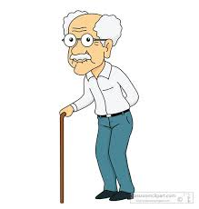
Case Study
Patient admitted with worsening heart failure
Switched to intravenous diuretics on admission
Aggressive diuresis results in signs of acute kidney injury
Ready for discharge but on lower doses of diuretic than on admission!
MDS tray required…
Needs a failsafe follow-up to ensure diuretics are escalated back to usual dose in 7-10 days

Slide 10
How will a UHS referral look?

Slide 11
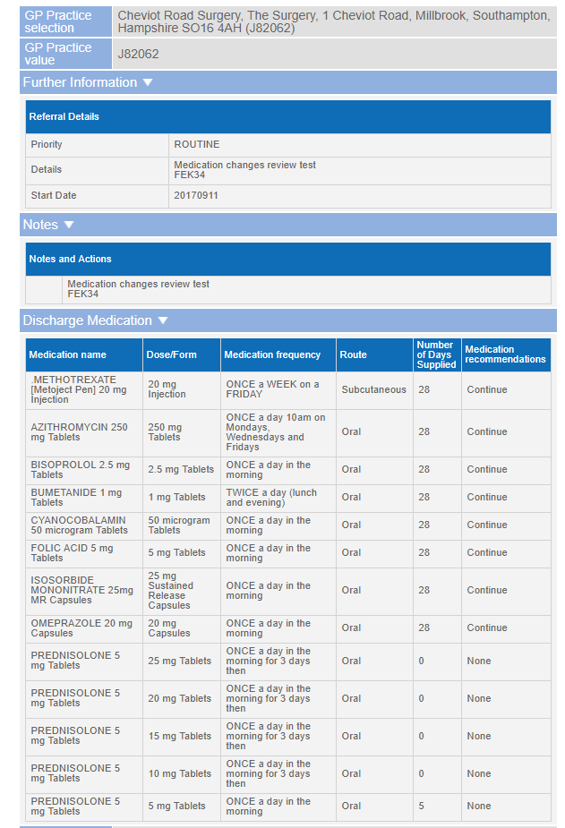
Referral reason / details

Slide 12
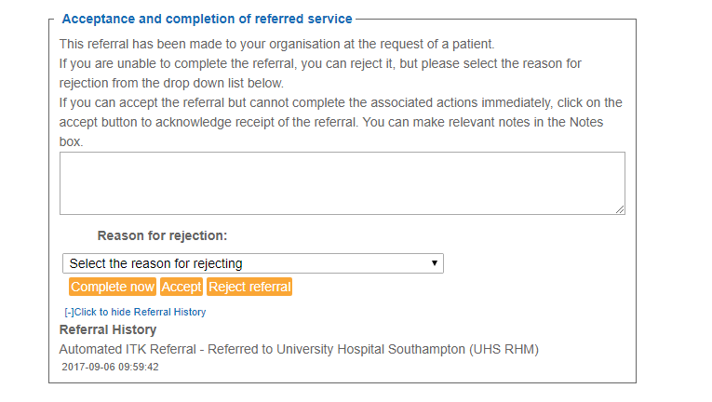
How do I deal with a referral?

Slide 13
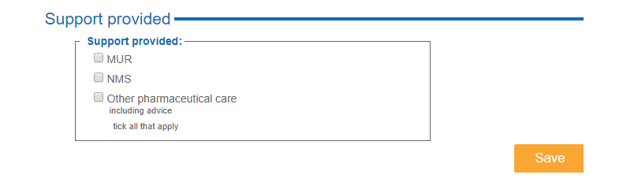
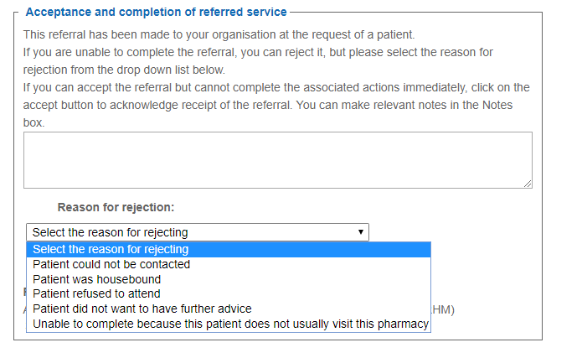

Slide 14
Measuring the impact and future work
Working with LPC & CCGs to measure local impact
  Raw numbers
  Re-admissions
  Interventions/success stories
Plan to share successes and learning at an event in late November.

Slide 15
Questions

Slide 16
References
1) Royal Pharmaceutical Society. Medicines Optimisation: Helping patients to make the most of medicines. 2013.
2) Wu JYF, Leung WYS, Chang S, Lee B, Zee B, Tong PCY, et al. Effectiveness of telephone counselling by a pharmacist in reducing mortality in patients receiving polypharmacy: randomised controlled trial. BMJ. 2006;333(7567):522.
3) Wilkinson T,S, Pal A, Choudry R,J, Impacting Readmission Rates and Patient Satisfaction Results of a Discharge Pharmacist Pilot Program. Hosp Pharm 2011; 46(11) 876-883.

